Slide 1
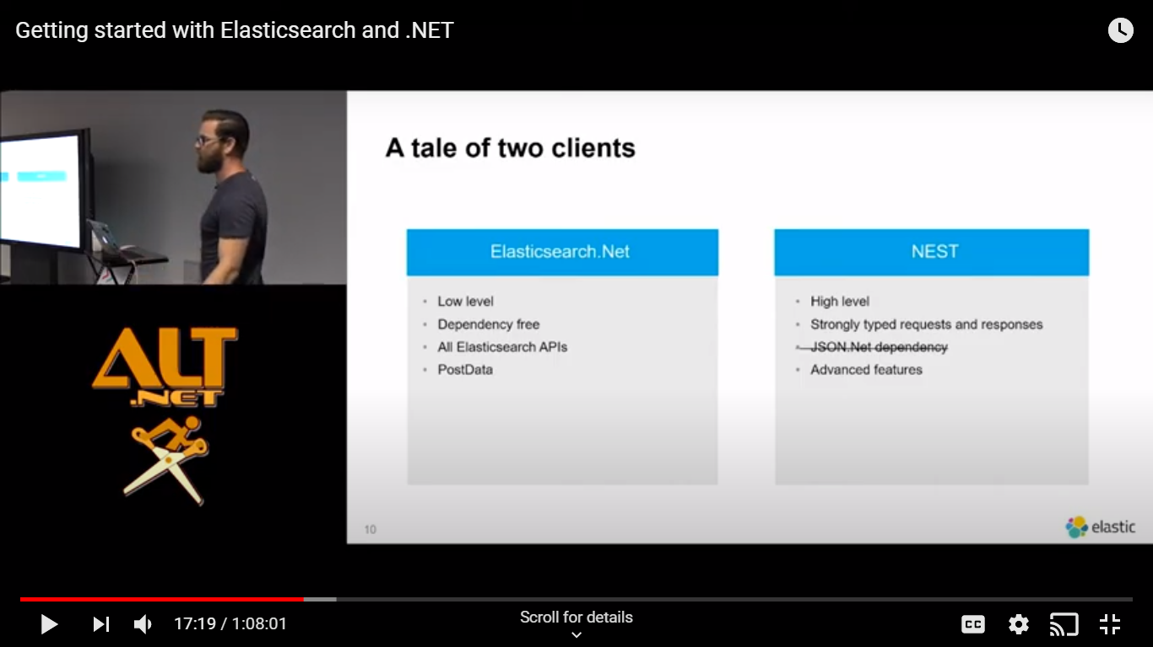
Elk .net

Slide 2
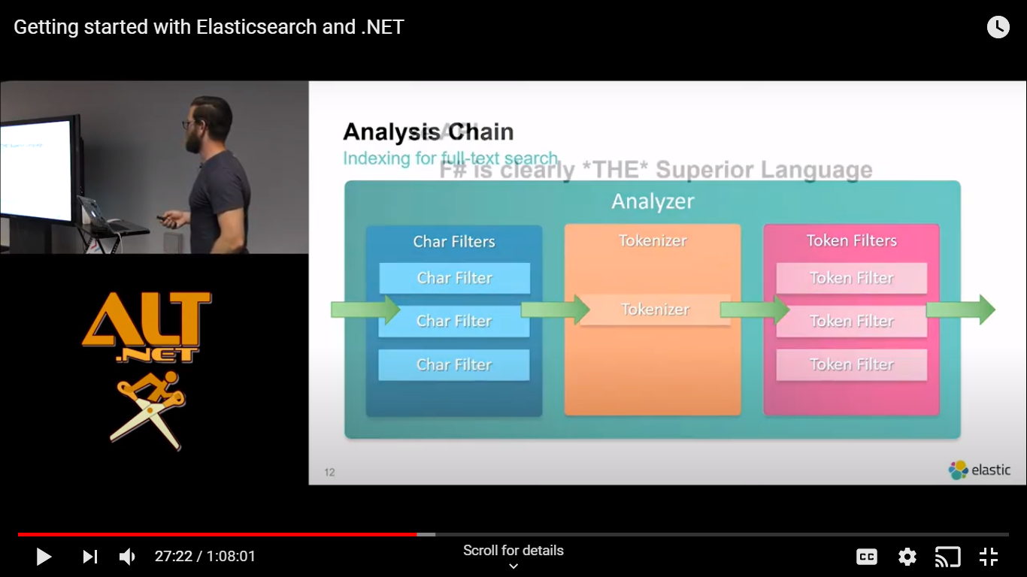
analyzer

Slide 3
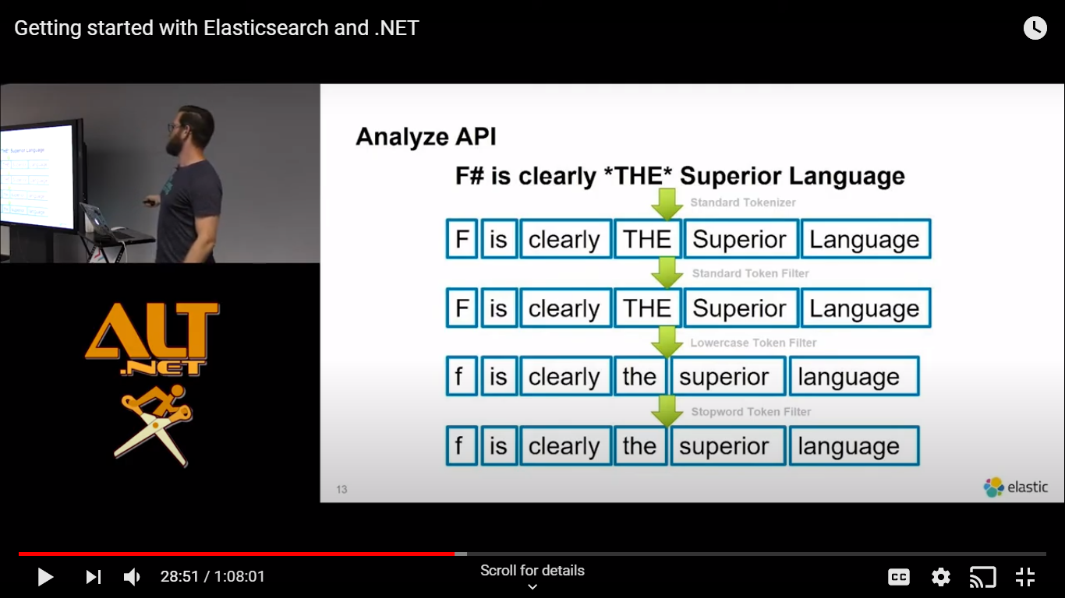
API

Slide 4
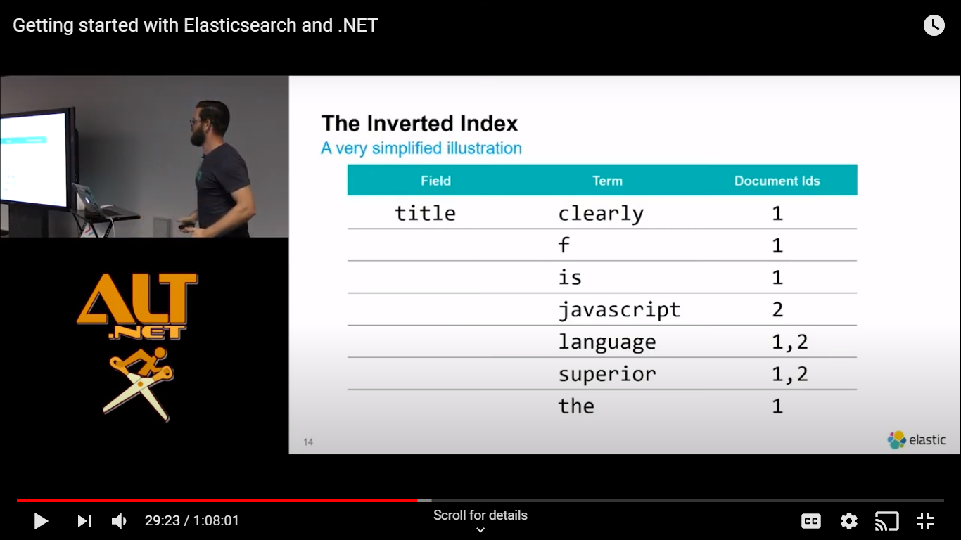
s

Slide 5
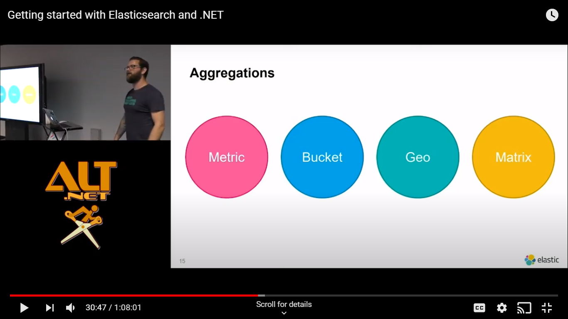
s

Slide 6



Cluster,node, index and shard

Slide 7

Primary
replica

